Slide 1
Introduction to Vectors
Unit 1 Topic 3

Slide 2
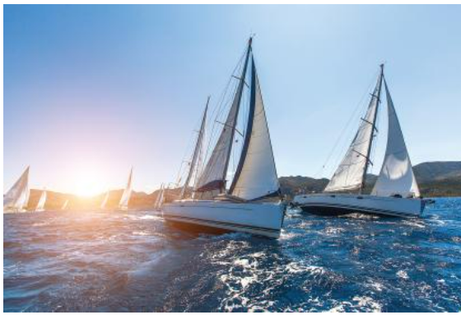
Vectors
Vectors are used in physics, e.g. describing forces
In animation (cartoons, moving objects, e.g. gaming)
Used in navigation, e.g. boating, flying aircraft
Vectors in the ‘plane’ means 2-dimensional plan.
We can also use/work with vectors in 3 dimensions (year 12 spec maths).

Slide 3
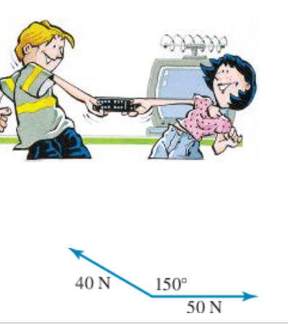
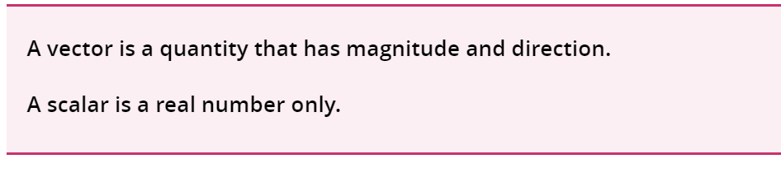
Definition of a vector
Vectors have SCALE and magnitude (size plus DIRECTION); vs SCALARs have just magnitude (size).
Vectors are useful to describe Forces as one application, and also navigation (in the past you would have done triangles)

Slide 4
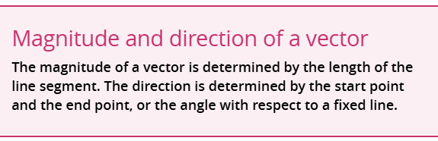
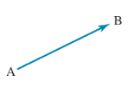
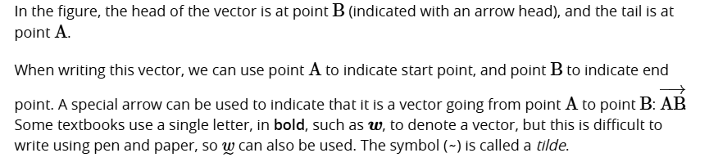
How to write vectors (notation)

Slide 5
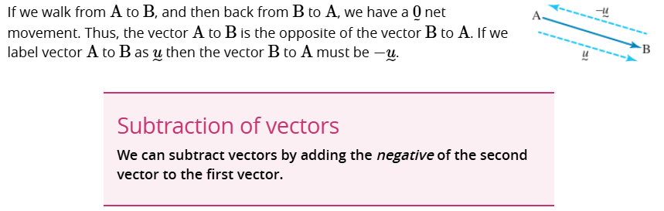
The negative of a vector

